Slide 1
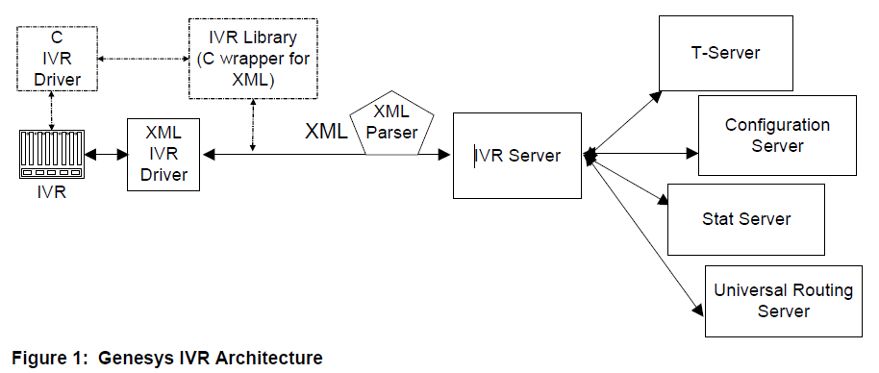
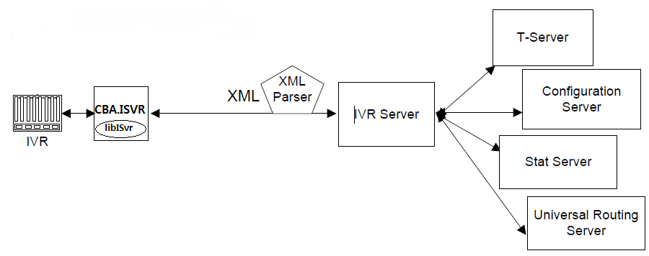
Genesys I/F Model

Slide 2
CBA.ISVR (CTI Bridge Adapter For Genesys IVR Server )
Start
MainThread
Start
CBManager
IVRDriverController
RequestQueue
CB
(Transaction Bridge)
Request
CBSession
Push
CB
(Transaction Bridge)
RequestQueue Polling Thread
CB
(Transaction Bridge)
CBSession
CB
(CTI Bridge)
Response
CBSession
…
CBSession
Processing
…
CBSession x n
ResponseQueue
ResponseQueue Polling Thread
Push
IDriverSession

Slide 3
Class Diagram
TcpSessionManagerBase
QueueBase
QueueItem
CBSessionManager
IServerSessionManager
QueueOfRequest
QueueOfResponse
TcpSessionBase
CBSessionListener
CBSession
IVRDriverController
libIVRDriver

